Slide 1
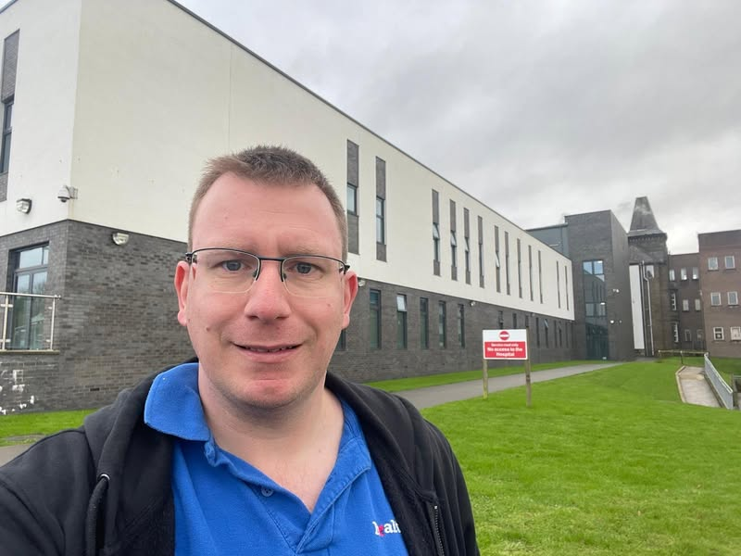
You Told Us
What we heard in November 2024

Slide 2
You told us…
…we listened
What have we heard in June?
Each month we analyse the feedback we receive to get an impression of the most common issues within the health and social care landscape in Lancashire.
This feedback informs our future engagement work and highlights any issues that we may need to escalate directly to a health and social care provider. We encourage people to share their experiences with us, and we offer information and signposting if people need further support or want to make a complaint.
This month we engaged with 327 people
We heard the most about:
GP services (51% of all feedback)
Other services we frequently received feedback about included:
Hospital services
Pharmacies

Slide 3
Your experiences:
GP Services
We regularly conduct Enter and View visits at GP’s surgeries (see our Enter and View reports on our website) and speak to patients using these services. People also call us or leave feedback on our website’s Feedback Centre. Some of this feedback is positive (see quotation below), but most relate to problems associated with:
Difficulties getting an appointment, including long waiting times on the phone (the ‘morning rush’)
Not being able to see a preferred medical professional
Poor communication
It's impossible to see my GP, if you ring up for an appointment you just get to see the practice nurse, if you insist on seeing the GP the appointment is weeks away and by the time you get to see them you're either better or become worse and had to go to A&E
Dentists
Many people in Lancashire are struggling to access an NHS dentist.
We are aware that many dentists surgeries are not currently accepting NHS patients. This is a national problem.
If you are struggling to access an NHS dentist in Lancashire and have a dental emergency, please call LSCFT dental services on 0300 1234 010.
Pharmacies
We have recently undertaken several Enter and View visits at pharmacies in Lancashire, primarily to look into the implementation of the NHS Pharmacy First initiative which launched in January 2024.
The initiative enables community pharmacies to complete episodes of care for 7 common conditions, including earache, sore throat, urinary tract infections, impetigo, and shingles.
Overall, we found the Pharmacy First initiative is relatively well known by pharmacy users, and seems to be working well..
During our visits we found that patients were generally satisfied with pharmacy services. We identified some problems with accessibility, especially with regards to the environment. Steps leading to entrances, for example, and heavy doors, can prevent disabled people from accessing these services without difficulties.

Slide 4
Engagement In focus
On November 11, 2024 we visited two groups in Preston and Chorley that support those living with Myalgic Encephalomyelitis (ME) and/or chronic fatigue syndrome (CFS). We had conversations with 11 people, focussing on issues around access to services and support after diagnosis.
The ME/CFS Service, run by Lancashire and South Cumbria Foundation Trust (LSCFT), aims to provide supportive, holistic, patient-centred advice to aid acceptance, education and self-management for adults with mild or moderate ME/CFS.
Both groups talked to us about issues around diagnosis and support. Patients explained that they felt abandoned by healthcare professionals after being diagnosed with ME. They were left with little help, support or follow-up treatment. They also expressed their feelings about how there is no follow-on communication about new medication or new developments, and they feel out of the loop.
“No up-to-date information for patients. New patients are told about new medication and new techniques, but I feel they forget about patients who have already been diagnosed.”
Concerns were raised about the awareness of ME and how more training is needed for healthcare professionals. Also, health professionals don’t always understand how someone who has ME feels and how the condition can change very quickly.
“Doctors don’t understand that living with ME can affect you in many different ways, including how you will feel the day of an appointment. You can get up, get ready and then the travel can floor you. They then expect you to speak with them and talk about your condition which isn’t always easy to do.”
Both groups spoke about how it can take a long time to diagnose ME, and noted that even after getting a diagnosis information on the condition provided by health professionals is limited. It is evident that participants felt communication was poor and support inadequate.
Participants also told us that they were often unsure whether they were feeling ill at any particular time because of their ME or something else. Moreover, some feel that healthcare professionals too readily explain their symptoms in relation to ME, rather than checking for other causes.
Some suggestions for better support included yearly checkups for patients to establish how they are feeling, and regular medication reviews. Also, a need for healthcare professionals to better understand what ME is and better access to support (including home visits).
These two groups, then, highlighted several barriers to support and help after a diagnosis of ME, and how difficult it can be to get follow-up treatment.

Slide 5
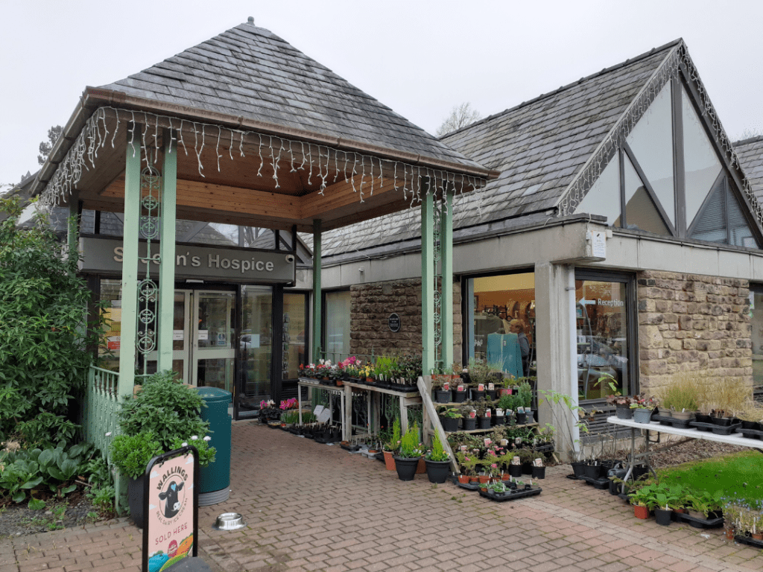
Engagement in focus
On 18th November we visited St John’s Hospice, which offers palliative care for the local community. The hospice provides both end-of-life inpatient care and care at home services, as well as the Forget-Me-Not Family Bereavement Centre, Courtyard Café and lots of day therapies and support for those with long-term and life shortening illnesses.
During the event, we spoke to seventeen people about local health services.
We heard positive feedback about Queen Square Medical Centre in Lancaster, particularly highlighting the ease of getting an appointment promptly and seeing the appropriate healthcare professional quickly. We will be sharing this feedback with the practice.
Feedback around the Emergency Department (ED) at Royal Lancaster Infirmary was less positive, with waiting times, the condition of waiting rooms and general dissatisfaction of care all mentioned. One person told us they had been several times recently and described their experience as ‘‘appalling”.
Healthwatch Lancashire will share this feedback with the University Hospitals of Morecambe Bay Trust (UHMBT), who manage Royal Lancaster Infirmary.
We were made very welcome by the St John’s Hospice team and were kept well supplied with cups of tea throughout the event which was greatly appreciated!

Slide 6
What else did we do?
65
People were signposted to the right place to get further assistance and help
3
The number of Enter and View visits conducted by the Healthwatch Lancashire team
Your feedback shapes the Enter and View visits we undertake and the focus of the many engagement events we attend across Lancashire. Please contact us by phone if you have a concern, or leave a message on our website’s feedback centre (see further details below).
The Healthwatch Lancashire team would like to thank everyone who has shared their experiences with us this month. Your feedback is vital to us!
The Healthwatch Lancashire team are available to talk between 9am and 5pm, Monday to Friday. We’re here to listen to your views and experiences, and we can help you find the health and care services you are looking for.
There are multiple ways you can share your feedback with us. If you have an inquiry, or want to share your general experiences, you can call the office on 01524 239100.
If you would like to leave feedback about a specific service, such as your GP Practice, care home or hospital the best place to do this is on our independent Feedback Centre at www.healthwatchlancashire.co.uk

