Slide 1
PF Induction
4th March 2021
Healthwatch

Slide 2
What we do
How we do it
Governance
Relationships
Engagement
Challenges
Projects and outcomes

Slide 3
Health and Social Care Act 2012
Significant reforms to the way Health and Social Care is commissioned
Greater public influence in Health and Social Care
Local Healthwatch organisations were launched on the 1st April 2013.

Slide 4
Activity
What do you know about Healthwatch and its statutory functions?

Slide 5
Statutory Functions
Provide information and advice to people across Cumbria and Lancashire about accessing health and social care services and choice in relation to aspects of those services
Promote and support the involvement of local people in the monitoring, commissioning and provision of local care services – including targeted activity to reach people protected by the Equality Act
Obtain the views of people about their needs and experience of local care services and make those known to those involved in the commissioning, provision and scrutiny of care services

Slide 6
Statutory Functions continued
Write reports and make recommendations about how those services could be improved
Make the views and experiences of people known to Healthwatch England and help it to carry out its role as a national champion
Make recommendations to Healthwatch England to advise the Care Quality Commission (CQC) to carry out a special review or investigations into areas of concern

Slide 7
Governance
Independent Board holding meetings in public
Delegated authority from the PF Board
Staff team
Volunteers
Strategic and local relationships

Slide 8
We work with 2 Health and Care Systems
Relationships are key
But it’s complex
Many organisations at each level

Slide 9
Engagement
Gathers insight
Builds networks

Slide 10
We all use services every day
Text here
Strong relationships across the whole health and care system

Slide 11
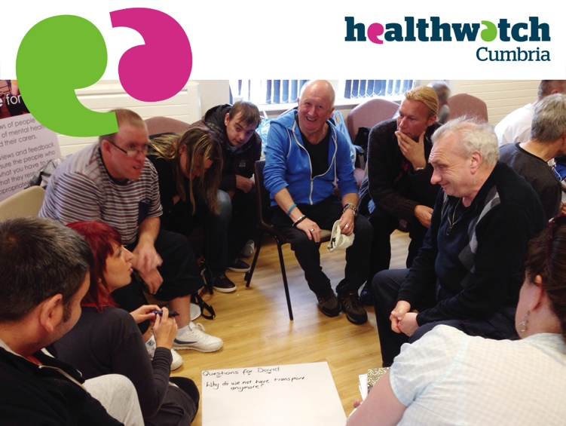
We listen to and record people’s experiences reaching all districts and in all communities including protected characteristics

Slide 12
Text here
We want to understand whether services are as good as they could be from a patient perspective?

Slide 13
People tell us about good and poor experiences
They talk about hospitals, GP practices, CHoC…
and mention specific services, access, travel, staff attitude, communication, treatments …

Slide 14
Text here
We have developed many opportunities to ensure this feedback can drive improvements

Slide 15
We’re ensuring that involvement and engagement of people is at the core of the decision making and improvement processes

Slide 16
In summary
Independent
Countywide
Listening
Engagement, evidence, reports
Impact, outcomes
Strategic and local relationships
Champion for health and social care
www.healthwatchlancashire.co.uk
www.healthwatchcumbria.co.uk

